Slide 1
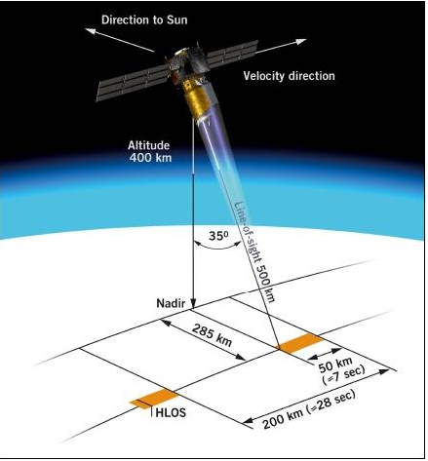
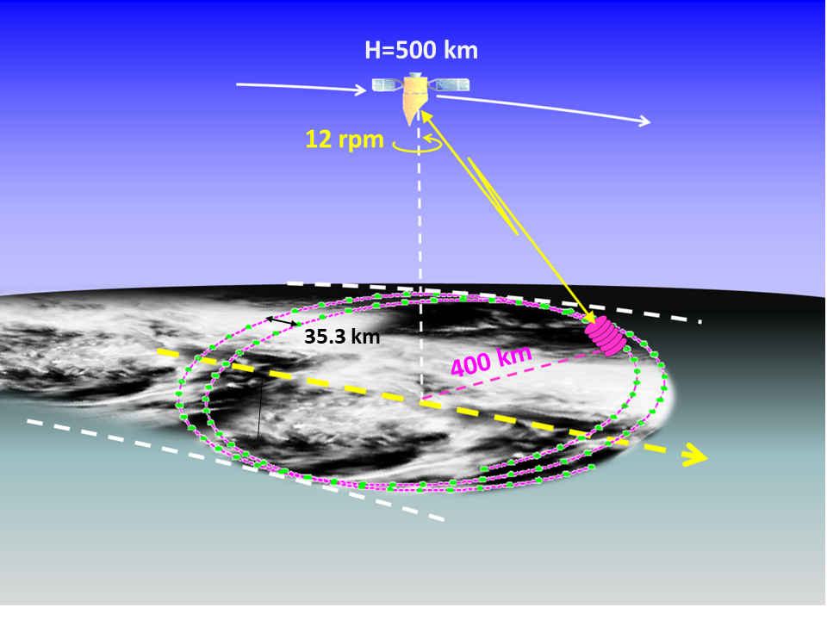
RADAR MEASUREMENT OF WIND AND RAINFALL FROM SPACE
Anthony Illingworth University of Reading, UK
ERAD 2022 Locarno Switzerland 29 Aug – 2 Sept 2022
Aeolus: WINDS ESA Launch 2018
355nm Doppler lidar. 38deg of nadir (no scan
Mostly clear air winds (molecular targets)
35deg off nadir. No scanning
Big impact in reducing NWP forecast errors
FOLLOW ON Proposed Launch ~ 2030
WIVERN PROPOSED SATELLITE FOR WIND AND RAIN.
94GHz scanning Doppler radar. 42 deg off nadir.
Phase zero studies at ESA – potential launch 2030 .
IN-CLOUD WINDS – would complement Aeolus
SCANNING so sample an 800km swath
BOTH LIDAR AND RADAR
POINT ~ 40DEG
OFF NADIR SO DOPPLER
SEES A COMPONENT
OF THE HORIZONTAL
WIND.

Slide 2
NWP/CLIMATE REQUIREMENT: GLOBAL OBSERVATIONS OF WIND and RAIN
with high time and spatial resolution - can only be obtained from space.
WIND - well behaved variable. Continuous in space and time throughout
the atmosphere. “Easy” to measure using the Doppler shift of targets that
move with the wind. Lidar – molecules and thin clouds. Radar – clouds.
RAIN - badly behaved variable. Discontinuous. Occurrence changes
rapidly in space and time. Attenuates the lidar signal.
Radar – must use higher rain-attenuating frequencies for small footprint
on Earth’s surface with a reasonably sized antenna. Z not measure R directly.
Best observations over the sea. Very difficult. (More difficult than sizing hail?)
How to validate satellite estimates of rainfall? Satellite a snapshot.
Gauges take time to accumulate rainfall. How to match with radar on ground?

Slide 3
In Europe windstorms cause €4.68Bn and floods €4.58Bn
damage each year (European Environment Agency, 2019).
ESA SUCCESSFULLY LAUNCHED A WIND LIDAR – AEOLUS ON 28 AUGUST 2018:
NOW PROVIDING WINDS OPERATIONALLY THAT ARE HAVING A SIGNIFICANT IMPACT
IN REDUCING ECMWF FORECAST ERRORS.
AEOLUS – 355nm lidar – pointing across track
– 35deg off nadir ~1km vertical resolution.
Doppler shift using:
molecules as a target (clear air winds)
(two broad band Fabry-Perot interferometers)
2. Clouds (Mie scattering) thin clouds/cloud tops.
(narrow band – Fizeau interferometer)
For Data assimilation typically:
87 km along track for clear air winds Precision 4-5m/s
14 km along track for Mie-cloudy winds. Precision 3 m/s
Jan 2020 - Operational data assimilation started at ECMWF.
Random errors are acceptable but,
BIAS MUST BE <2m/s otherwise forecast worse!.
RECENTLY LASER POWER FALLING AND WINDS MUCH NOISIER

Slide 4
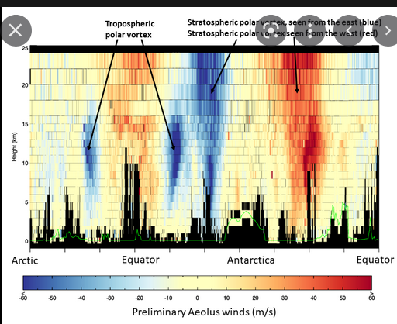
TROPOSPHERIC STRATOSPHERIC POLAR VORTEX
POLAR VORTEX CHANGES SIGN OVER S POLE
First image released
just two weeks
after launch.
Sept 2018.
BLACK AREA
CLOUDS

Slide 5
FIRST COMPARISON WITH WINDS IN ECMWF FORECAST MODEL ANALYSIS
A. All winds about 8 m/s too high.
This was due to uncertainty in the precise form of the backscatter
spectrum at 355nm. Semi-empirically tweaked to remove. Fix within weeks.
B. Bias of the winds changing rather irregularly around the orbit.
Detective work by Mike Rennie (ECMWF): biases correlated with
the upwelling IR in the ECMWF model, i.e. cloud top temperatures.
Upwelling IR correlated with temperature pattern of thermistors on the
back of the receive Empirical fit of IR to the thermistors fixed the problem.
This took several months.
Mike Rennie is a member of the WIVERN Mission Advisory Group.

Slide 6
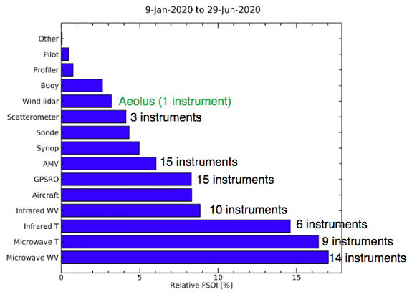
Impact of winds from Aeolus in reducing forecast errors
“FSOI”- Forecast Sensitivity to Observation Impact:
Powerful tool to quantify impact of e.g. radio sondes, wind profilers v. Mode-S
Impact of each type of observation in reducing
the error in the forecast for ECMWF model from
9 Jan to 29 June 2020.
Aeolus has the largest impact (~3%) of any
single instrument although it has just in
1% of the total number of observations.
About 200k winds a day were being assimilated
from Aeolus with a precision is 4-5 m/s.
FOLLOW ON MISSION SUBMITTED
FOR APPROVAL AT THE MINISTERIAL
MEETING THIS AUTUMN
LAUNCH ~ 2030
Wind sea surface
Atmospheric Motion Vectors from successive satellite images.

Slide 7
WIVERN – RADAR CONCEPT
500km orbit 800km wide ground track:
41.6° off zenith at surface
One rotation in 5 seconds (12 rpm)
- move 35km along track
For representative winds suitable for data
assimilation accurate 2m/s averaged 20km along footprint track.
3m antenna (maximum possible with current launchers) 94GHz for a narrow beam:
Beamwidth at the surface 800 m. Pulse length 500m (3.3μs)
1. DOPPLER line of sight winds – using cloud particles as tracers.
Winds inside tropical cyclones + deepening Atlantic (and Mediterranean) depressions
Complementing Aeolus Doppler lidar clear-sky and cloud top winds (+ Aeolus follow on)
2. RADAR REFLECTIVITY precipitation rate, cloud profiles, cloud ice water content
PROPOSAL TO ESA 2020 – LED BY ILLINGWORTH AND BATTAGLIA – NOW IN PHASE ZERO
(WIVERN = ”Wind Velocity Radar Nephoscope”)

Slide 8
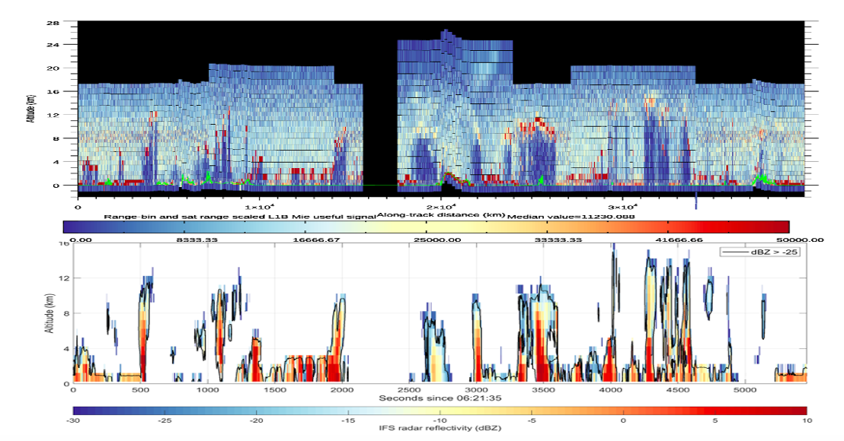
ONE ORBIT OF AEOLUS DATA - PHOTON COUNTS - 3km horizontal resolution - DEEP BLUE SIGNAL LOST BECAUSE OF CLOUDS
ECMWF forward modelled radar reflectivity
FOR dBZ >-15dBZ (blue/yellow) 20km integration wind precision +/-2m/s (-25dBZ, deep blue, +/- 6m/s)

Slide 9
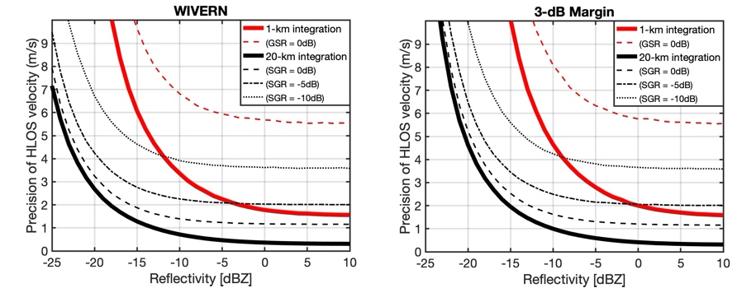
HOW MANY WINDS A DAY DO WE EXPECT FROM WIVERN?
BOLD BLACK LINE 20km integration (for data assimilation
precision of wind 2m/s for Z > -18dBZ (-15dBZ with 3dB margin)
RED LINE for 1km (convective scale) -5dBZ
FROM CLOUDSAT GLOBAL CLIMATOLOGY of reflectivity profiles
EXPECT ~ 1 MILLION PER DAY OF 20km winds (Z > -15dBZ)

Slide 10
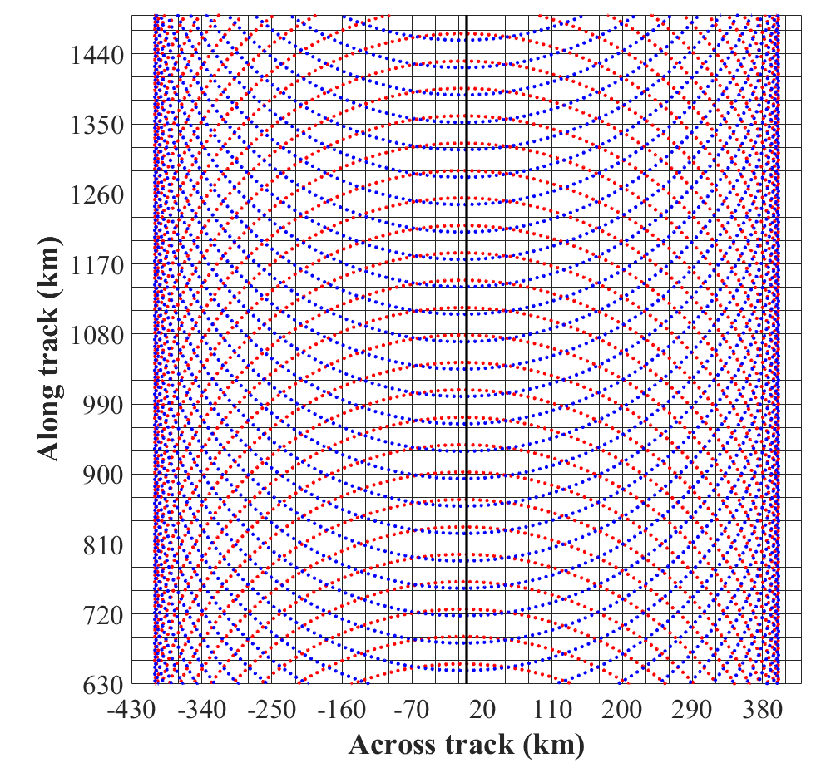
GLOBAL SAMPLING: EACH 30 km BOX IS VISITED WITH A “CURTAIN” OF RADAR DATA
CROSSING IT EACH DAY (ON AVERAGE) UP TO +/-82DEG LATITUDE
800km swath
Sub-satellite point moves at 7km/s.
35km movement along track per circular scan
(5 secs/12rpm)
On the average, each 30km x 30km box has at least one track across it each day to provide wind profiles and rain rates.
Forward view
Rear view

Slide 11
94GHz FROM SPACE? POLARISATION DIVERSITY PULSE PAIR “PDPP
We need folding velocity of ±40m/s, pulse separation 20µsec/ 3km
PDPP: Use two pulses H & V, effectively “labelled” H & V,
OK if they transmit, scatter and are received independently.
RANGE
PULSE SEPARATION
20µsec OR
3km slant path
(2.3km in the vertical
In that 20µsecs
the target moves
λ/4 in range
H pulse
TIME
φ_{H}
V Pulse 20µs later
λ/4
φ_{V} = φ_{H} + 180°
FOLDING VELOCITY: 800µm in 20µsec = ±40m/s.
If measure phase to 1deg accuracy, better than 0.25m/s
Max Line of sight wind expected +/-120 m/s (horiz wind +/-150m/s)
One fold expected as a maximum. Unfolding OK.
(see next talk by Katia Lamer et al on Doppler from space)

Slide 12
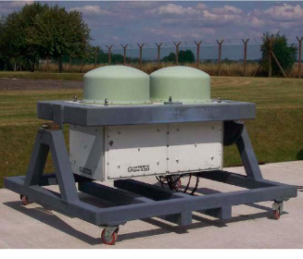
ESA has funded 2 PDPP systems: one ground based and one airborne on the Canadian Convair 850
They transmit H-V 20μs pulse pairs alternating with from 250μsec H-H pulse pairs, the TRUTH. Extensive observations confirm the PDPP velocity is the same as PP velocity. EXACTLY THE SAME PDPP SYSTEM WILL BE USED ON THE WIVERN SATELLITE
GROUND BASED- CHILBOLTON UK CANADA NCR CONVAIR 850 AIRCRAFT
MANY HOURS OF DATA TO CHECK PDPP DOPPLER GIVES RELIABLE WINDS
CROSS TALK. DEPOLARISING TARGETS, PULSES 3km APART, VERY LARGE CHANGE IN Z OVER 3km,
the return from the high Z regions will give a GHOST ECHOES IN THE LOW Z REGION
Yes, but the cross-talk signal will have random phase – MAKE WINDS NOISIER BUT NO BIAS

Slide 13
INDUSTRY STUDIES FOR WIVERN
Antenna pointing knowledge – need to remove the sinusoidal
component of the satellite motions having amplitude 5000 m/s
Need pointing knowledge to about 40urad (3-sigma) in 10secs.
TED (Thermoelastic Deformation) and Vibration of Antenna.
Free Space Rotary Joint to feed H and V pulses to the antenna
Breadboard system has been tested.

Slide 14
THUS FAR THREE RADARS HAVE ESTIMATED RAINFALL FROM SPACE:
TRMM Nov 1997-April 2005 +/- 35deg N and S
13.8GHz (Ku) V resolution 250m
Swath 220km, footprint 4.3km at nadir.
Rainfall “2A-25” from Z profile and PIA (path integrated attenuation) ocean only
GPM 2014 -
13.8GHz (Ku) and 35.8km (Ka) V resolution 250m
Swath 125km for dual frequency Footprint ~ 4km
Rainfall “KuPR” “KaPR” and DPR using Z profiles and PIA
CloudSat 2006- Nadir pointing (same as EarthCARE to be launched 2023)
94GHz V resoln 500m (same transmitter as proposed for WIVERN)
Rain rates from PIA and Z profile. Need to correct PIA for cloud water attenuation
(equiv to about 0.5mm/hr of rain , but observations very scarce)
and melting layer attenuation ~ 2 R dB (also uncertain, need more observations)
where R is rain rate, and Rain attenuation is ~ 1.7 dB/km (2-way) per mm/hr.

Slide 15
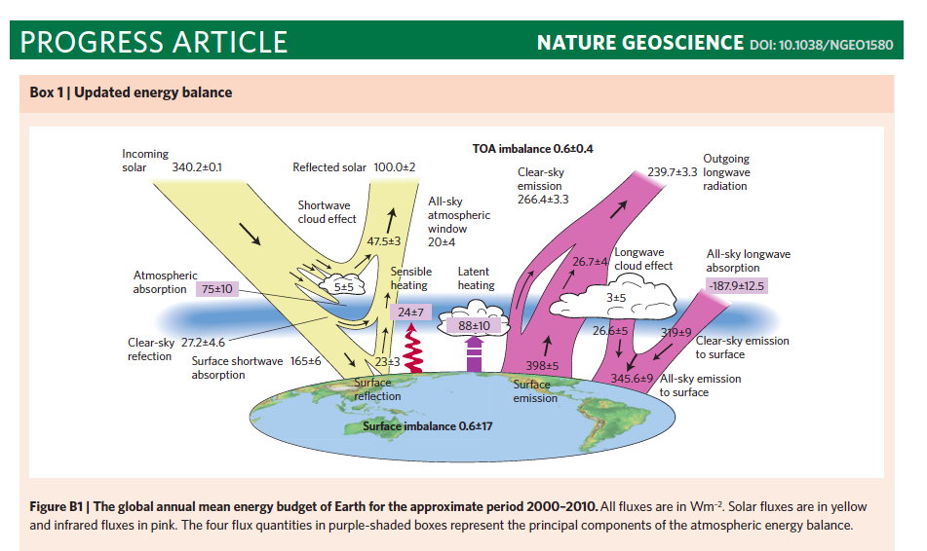
STEPHENS ET AL. 2012 based on CloudSAT rain observations
LATENT HEAT FROM PRECIPITATION 88 +/10 W/m² 1mm/day is 29 W/m² (Av rain rate 3 mm/d)

Slide 16
STEPHENS ET AL. 2012 based on CloudSAT rain observations
Global Precipitation Climatology Project had the Latent Heat Term 76 W/m²
Nature note using precipitation information from CloudSat proposed:
+ 4 W/m² extra from snow (not considered by GPCP)
+ 8 W/m² ( increase of 10% in global rainfall)
to give new estimate of
LATENT HEAT FROM PRECIPITATION 88 +/10 W/m² 1mm/day is 29 W/m² (Av rain rate 3 mm/d)
For the global energy balance – need average global rainfall to within a few %
- will this ever be possible?

Slide 18
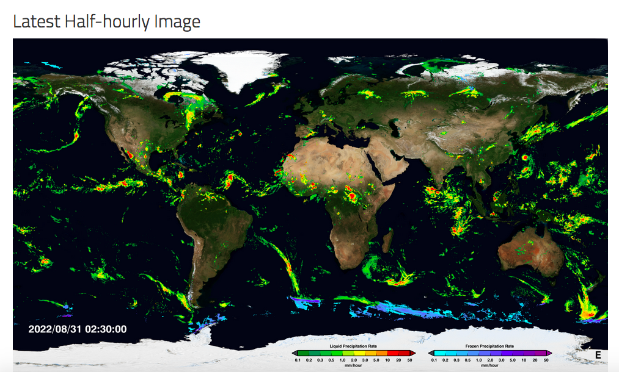

Slide 19
How good is the IMERG global product at 11km available every 30 minutes?
4 second radar composite over an area 275 by 275km of New Zealand compared with IMERG
Courtesy of Luke Sutherland-Stacy and Beatriz Reboredo Viso of WRNZ
(talk on Tuesday afternoon at 1445h in the Hydrology session)

Slide 21
THE CHALLENGE OF VALIDATING SATELLITE ESTIMATES OF RAINFALL
d) Satellite retrievals use PIA – only available over the ocean
Paucity of scanning radars (or gauges) over the sea

Slide 22
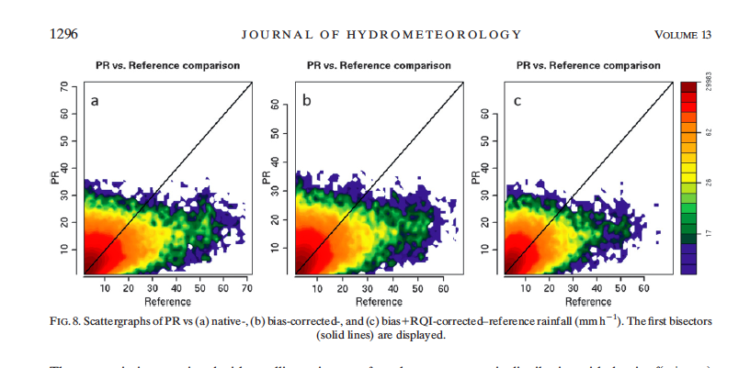
Scatter plots of TRMM PR rain rates at the 4km satellite footprint resolution
for March-May 2011 against the rain rate from the ‘MRMS’ (multi-radar multi-sensor)
ground based radars for,
a) native data, b) bias corrected (using gauges), and c) bias and quality-controlled radar data.
Average standard deviation is ~ 7mm/hr, bias is -18, -11 and -23%, respectively.
(From Kirstetter et al. 2012)

Slide 23
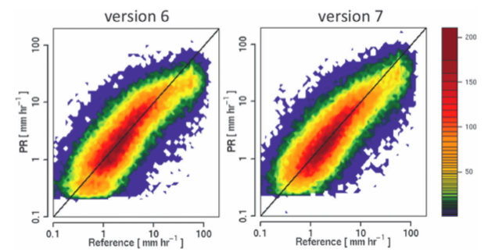
Scatterplot for the TRMM rain product 2A25 V6 and V7 at 4km resolution
against the radar reference for the 392,713 data pairs
Solid lines: the 1:1 line.
For version 7: rms error = 9.8mm/hr: bias -18% (from Kirstetter et al., 2013.)

Slide 24
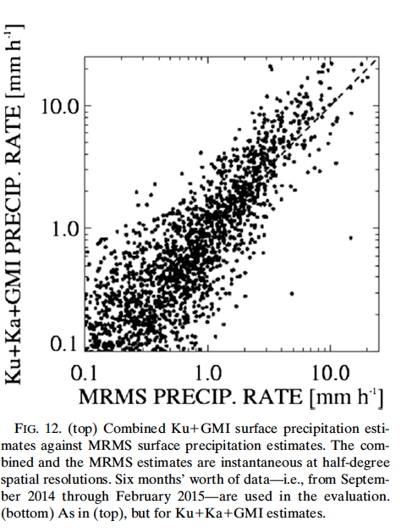
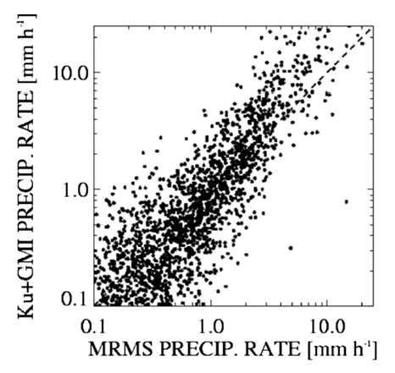
Performance of the rain retrievals from the GPM radar and GMI at 50km resolution
for Sept 2014 - Feb 2015 when compared to the MRMS radar ground truth.
Left - ‘N’ - Normal swath, 35.5Ghz radar only.
Right – ‘M’ matched swath, both radars.
Correlation is 0.8 to 0.84, and about 50% of the estimates are within 50%
of the MRMS estimates at 1mm/hr, some increase in error for higher rain rates. (from Grecu et al. 2016))
Ku + GMI
Ku + Ka +GMI

Slide 25
GPCP comparison at the satellite footprint resolution of 4km for the single frequency data for
the period June 2014 to Aug 2015.
(from Skolfronick-Jackson et al. 2017)

Slide 26
50km DATA MUCH BETTER
Normalised error of the GPM rain estimate in previous figure but at 50km resolution
when compared with the MRMS ground based precipitation rate.
Solid line: bias – the mean relative error, dashed line – mean random error.
Outliers outside the 5% - 95% inter-quantile range are excluded.
The red dashed lines are the GPM mission requirements of 50% error at 1mm/hr and 25% at 10mm/hr.
These are met once outliers are excluded. The bias varies between +/- 20%

Slide 27
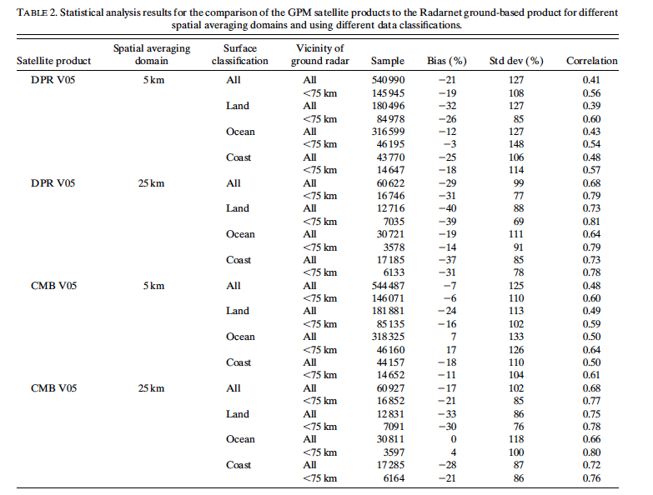
Statistical analysis of the GPM satellite products compared with
ground based radar estimates over the UK at 5km and 25km averaging domain
for the DPR (dual frequency precipitation radar) alone, and CMB
when combined with the GMI (GPM microwave imager). From Watters et al, 2018).

Slide 28
QUESTION FOR THE AUDIENCE
IS THIS THE GPM STATE of the ART?
CAN WE HOPE TO RETRIEVE
ACCURATE 5km RESOLUTION RAINRATE
OBSERVATIONS FROM SPACE?

Slide 29
Spare slides

Slide 30
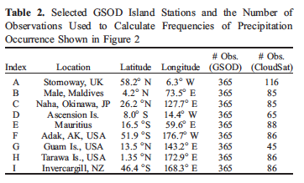
Island stations used for validating CloudSat rain fall occurrence.

Slide 31
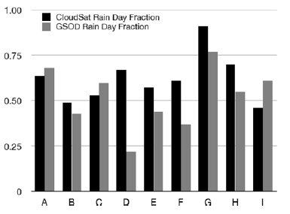
Comparison of the number of rain days in 2006-2007 at nine selected island stations in Table 2.2.
versus the number of rain days observed by CloudSat in the 2.5 by 2.5 latitude box centred on that station.

