Slide 1

WIVERN: A New Satellite to Provide
Global In-Cloud Winds, Precipitation and
Cloud Properties.
WIVERN:
A WInd Velocity Radar Nephoscope:
“Earth Explorer 11 Candidate”
WIVERN should provide in-cloud global winds, rain, snow cloud ice water content and convection with 60km horizontal and 1km vertical resolution and daily visits poleward of 50°
Anthony Illingworth, U of Reading: Alessandro Battaglia, U of Leicester
+ science team including those who assimilate winds
in ECMWF, UK Met Office, DWD, MeteoFrance
NCEO-CEOI CONF 24-25 June 2020

Slide 2
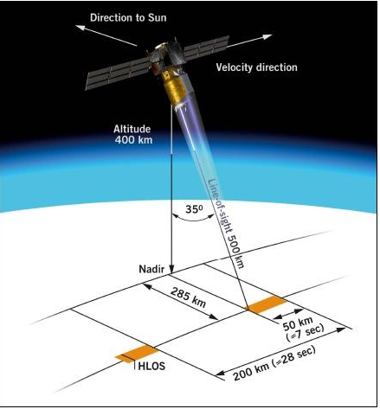
WINDS AND ASSOCIATED RAINS/FLOODS ARE BY FAR THE
MOST DAMAGING METEOROLOGICAL PHENOMENA
ESA SUCCESSFULLY LAUNCHED A WIND LIDAR – AEOLUS ON 28 AUGUST 2018:
NOW PROVIDING WINDS OPERATIONALLY THAT ARE HAVING A SIGNIFICANT IMPACT
IN REDUCING ECMWF FORECAST ERRORS - A second lidar mission is planned.
AEOLUS – 355nm lidar – pointing across track – 35deg off nadir.
Measure Doppler shift using molecules as a target (clear air winds)
and cloud particles (Mie scattering) for thin clouds.
One week after launch comparison ng with ECMWF model winds:
Biases of winds for ascending orbits opposite sign to those of
descending orbits caused by lidar not pointing exactly across track
- picking up a component of satellite motion.
For assimilation best is 1km vertical resolution and 87km along track for
ECMWF model - 10km grid so represents features of size ~ 50km.
9 Jan 2020 - Operational. Monitoring confirms 2% reduction in RMS error for wind and temperature, even though random wind errors 3-5 m/s (2m/s specifation) BIAS MUST BE <2m/s otherwise forecast worse!.
WIVERN’S RADAR WOULD PROVIDE COMPLEMENTARY BROAD-SWATH IN-CLOUD WINDS

Slide 3
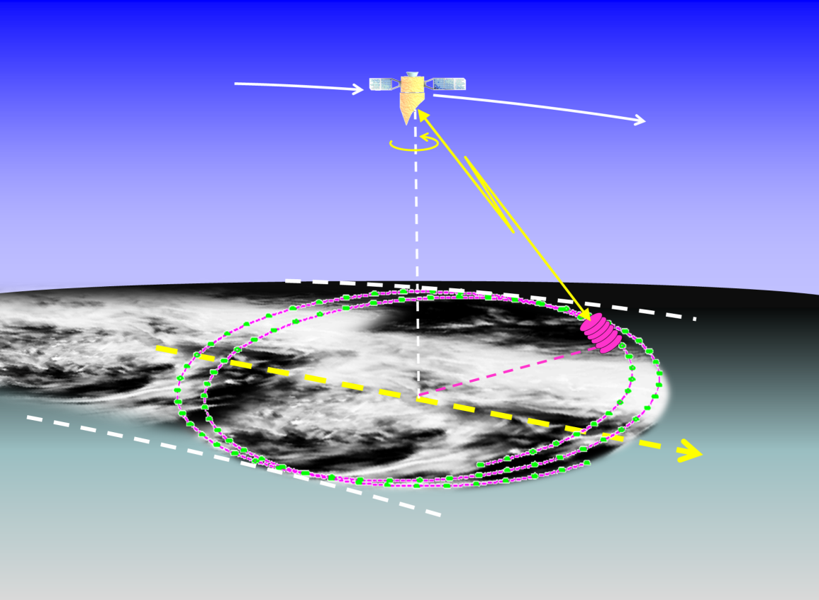
WIVERN – RADAR CONCEPT
500km orbit
800km wide ground track:
Slant range 651km
Conical scan 37.9° off-nadir
(41.4° off zenith at surface)
One rotation every 8 seconds
- move 60km along track
For winds accurate 2m/s:
- sample 20km around the arc if Z >-20dBZ
1km around the arc if Z > -7dBZ
94GHz: 2.9m elliptical antenna: 1.23mrad:
Narrow Beamwidth 800m: Pulse length 500m (3.3μsec) 1km vertical resolution
Radar Reflectivity: cloud profiles, precipitation rate, ice water content.
DOPPLER line of sight winds – using cloud particles as tracers.
COMPLEMENTS: the predominantly clear air winds from AEOLUS
Winds inside tropical cyclones + deepening Atlantic (and Mediterranean) depressions

Slide 4
MAJOR DRIVER: VERTICAL RESOLUTION <1km
800km SWATH – 500km orbit – range 650km,
2.9m by 1.8m elliptical antenna; 0.07°/ 1.23mrad, beam width 800m
Single pulse length 500m
Vertical
Resolution
800m
800m
41°
BLIND Clutter zone = ?
Ground footprint -
about 1km
Ground
Canadian aircraft observation of 94GHz SURFACE CLUTTER AT 40deg incidence CLUTTER ZONE < ~1km over ocean, < ~ 2km over land.
Notes:
4

Slide 5
The two H & V pulses separated by just 3km are effectively ‘labelled’: they transmit, scatter and are received independently
  DOPPLER FROM SPACE?
  Transmit a pulse pair: detect phase shift, ϕ, between the returns.
  The maximum unambiguous velocity (V_{FOLD}) occurs when ϕ = 180°
  and the particles have moved λ/4 ( at 94GHz this is 800μm),
  So pulses must be very close, need to label them H and V
H pulse
TIME
PULSE SEPARATION
20µsec OR 3km
(2.3km in the vertical
In that 20µsecs
the target moves
λ/4 in range
φ_{H}
V Pulse 20µs later
λ/4
φ_{V} = φ_{H} + 180°
FOLDING VELOCITY: 800µm in 20µsec = ±40m/s
POTENTIAL PROBLEM: – DEPOLARISING TARGET (BRIGHT BAND OR THE GROUND)
WILL FORM A “GHOST ECHO” WHERE THE OTHER PULSE IS ( +/- 2.3km ABOVE OR BELOW)
However the phase of this ‘ghost echo will be random – so the only effect will be to
increase the random error of the wind estimate – NO BIAS

Slide 6
HERITAGE
CloudSat: first 94GHz radar in space. Nadir pointing: 1.4km wide swath
Radar transmitter performed beyond expectations since launch in 2006
and after 14 years is not yet using the spare tube!
CloudSat measures radar reflectivity profiles and has provided:
First profiles of global cloud occurrence and ice water content.
Best global estimates of light (< 5mm/hr) rainfall.
WIVERN is low risk – will use the same tube, same prf (4kHz) same pulse
power, same pulse length (3.3us/500m).
WIVERN will use 2 tubes, to transmit pulse pairs, H and V, separated by
20usec (3km) to provide Doppler velocities.
4kHz prf – satellite moves 7km/sec,
so for the 1km footprint will be sampled by 500 pulse pairs,
or for our 20km along track sample will have
> 10,000 pulse pairs to get Doppler to 1 or 2m/s if Z > -20dBZ
(~ 10% of pulses will be single – to monitor the LDR of target and possible ghost echoes)
From the CloudSat Z climatology should get ~ one million winds per day.
Remember the 94GHz radar will not penetrate severe convection > 10mm/hr – attenuation.

Slide 7
POTENTIAL SOURCES OF ERROR:
1. GHOST ECHOES.
2 WIND SHEAR AND REFLECTIVITY GRADIENTS
3. INDUCED WIND SHEAR BY ROTATING ANTENNA
4. ANTENNA POINTING KNOWLEDGE
5. HORIZ WINDS FROM 41 DEG SLANT VIEW
We have analysed six months of 94GHZ data using ground-based H-V 20usec pulse separation radar at Chilbolton at 45 deg elevation,
also has ‘standard” Doppler pulse-pair “truth (as used for winds for the last 70 years)
– High resolution data 60m and 5 seconds – providing 100s of sub samples
of the WIVERN sample (500m by 800m)
Ghost echoes – found one occasion which increased the noise of the velocity estimate by up to 0.5m/s and confirmed that such occasions from space could be recognized by the drop in the correlation of the H-V reflectivity time series.
Wind Shear – found one occasion with 20dBZ/km reflectivity gradient and 20m/s/km wind shear – induced up to 1m/s bias, but this could be recognized from the changes in Z measured from adjacent WIVERN gates.

Slide 8
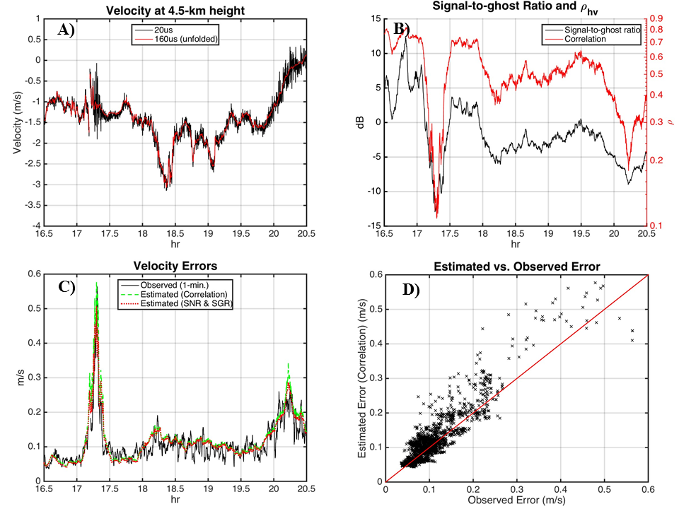
1. GHOST ECHOES 27 Jul 2017 caused by bright band.
BLACk
line H-V
velocity
RED line
true
VELOCITY
Red line Observed
correlation of the
200 H and V pulses
drops from 0.7
to 0.2 at 17.3h when
ghost appears.
H-V
random
velocity
error
17.3hr
reaches
0.5m/s
Predicted increase
In random velocity
error from the
observed correlation
v.
Observed random
Error.

Slide 9
2. WIND SHEAR AND REFLECTIVITY GRADIENTS?
WIND SHEAR
Z GRADIENT
RADAR
PULSE
TRUE WIND
HEIGHT
WIVERN WIND
AEOLUS corrects for this effect using the known air density change with height.
Ground-based operational C-band Doppler radars make same correction for vertical gradient of Z.
WIVERN: Typical wind shear 5 m/s/km, but active weather systems 10 m/s per km,
if we have a coincident Z gradient of 20dB/km, will induce a bias of 0.8m/s
We have searched through two years Chilbolton 94GHz data taken at 45deg
elevation with H-V separation 20usecs and found one case:

Slide 10
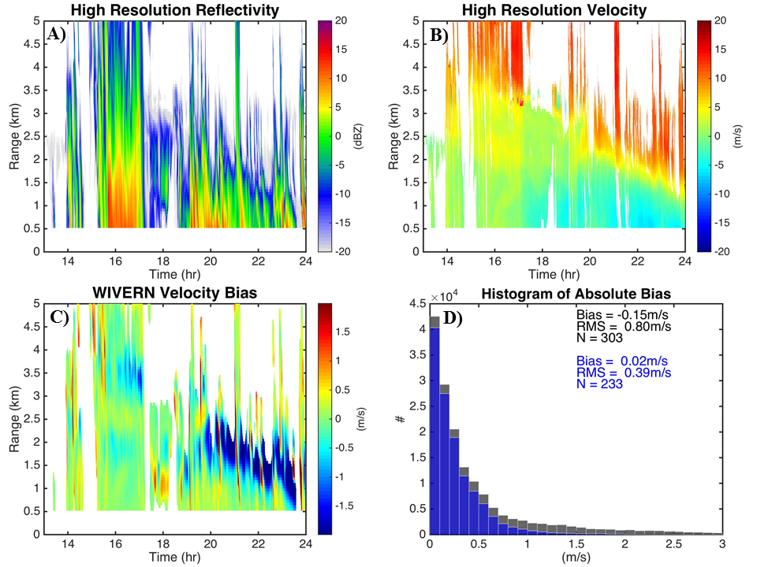
2. BIAS DUE TO wind shear and Z gradient 27 June 2017
Z GRADIENT
20dBZ/km
WIND SHEAR
15 m/s/km
VELOCITY BIAS at WIVERN RESOLUTION
233 PIXELS.
MEAN -0.15m/s
CORRECT USING
Z GRADIENT OBSERVED BY WIVERN
MEAN BIAS 0.02m/s
WIVERNVELOCITY
BIAS predicted
From high
resolution
Chilbolton data

Slide 11
3. What about an apparent wind shear induced by the rotating antenna?
5km/sec
component of
satellite motion
at 42 deg
Elevation.
Radar beamwidth ~1 mrad (0.05degs)
So induced wind shear up to 5m/s across the beam
A reflectivity gradient of 20dB/km
will induce a bias of about 1m/s.
We could search the CEDA data base of the UK radar network
At ranges < 45km from each radar (so beamwidth < 500m) to see
if we can find 20dB Z gradients extending in a straight line for 20km.
.
4. Critical issue – need pointing knowledge (azimuth and elevation) of the rotating antenna to 200urad (a fifth of the beamwidth) for < 1m/s bias. (platform orientation known to 20urad using star trackers.)
For azimuth – use the same method as Aeolus – match winds for ascending and descending orbits.

Slide 12

MONITORING THE ELEVATION ANGLE OF WIVERN – USE THE RADAR AS AN ALTIMETER
Satellite moves at 7km/s
Sea surface
Blue – the range remains constant when the antenna rotates around an axis pointing to nadir.
Red – the range varies sinusoidally if the radar rotates about an axis that is slightly off nadir.
AMPLITUDE OF SINUSOID 651km*200urad = 130m.
Correct for this in hardware (adjust axis of rotation) or software
QUESTION: DOES THE SEA SURFACE CHANGE BY 100m OVER A DISTANCE OF 800km?
(Panama Canal 26m)

Slide 13
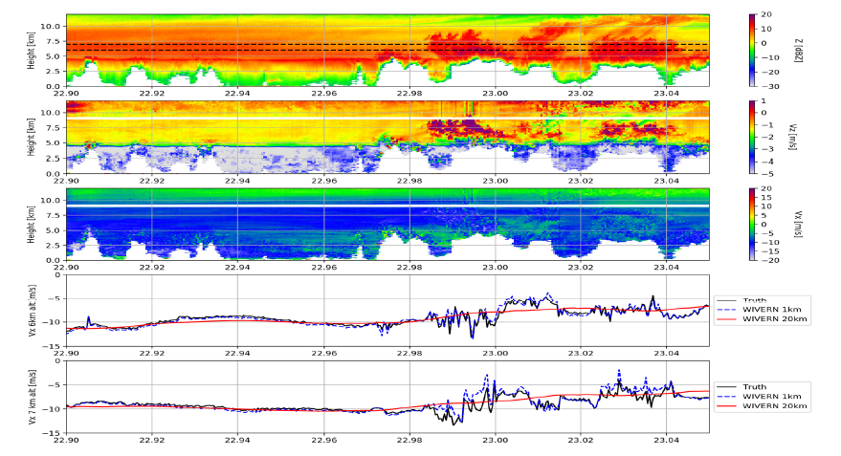
5. Can we derive true horiz winds when looking 41 degrees off nadir?
Radar observations by the French Falcon aircraft with three antenna pointing in different directions through a tropical rainstorm near Darwin. (Courtesy Julien Delanoe, LATMOS)
An 80 km vertical cross section of tropical rainfall observed by a 94 GHz radar showing the reflectivity and 3-D velocities. Heavy rain completely attenuates the signal below ~ 2.5km.
First 40 km of stratiform rainfall Second 40km of convective rainfall.
dBZ
V(vert)
V(horiz)
Can compute WIVERN line of sight (LOS) wind, and apparent HLOS = LOS (cos 41degs)

Slide 14
Bottom panel: the HLOS velocity at 1 km resolution and 20 km resolution inferred by WIVERN at height of 6km
BLACK line is the true horizonal velocity measured by the radar. (Assume ice falls at 1m/s)
HYPOTHESIS IF the rms variation of 1km wind over 20km is < 0.5m/s – we have stratiform rain
if rms variation of the km to km wind over 20km is > 1.3m/s - we have convective rain
MORE FLIGHTS CAPE VERDE JULY 2020: also analyse ‘EPATAN’ flights near Iceland/Greenland 2016

Slide 15
Other issues to investigate
1. Antenna stability – will it wobble as it rotates?
2. Feeding H and V signals to the rotating antenna
Thermo-elastic stresses on antenna. OK to 200urad?
Also need to supply a budget of the cost of the elements
of the satellite platform

