Slide 1
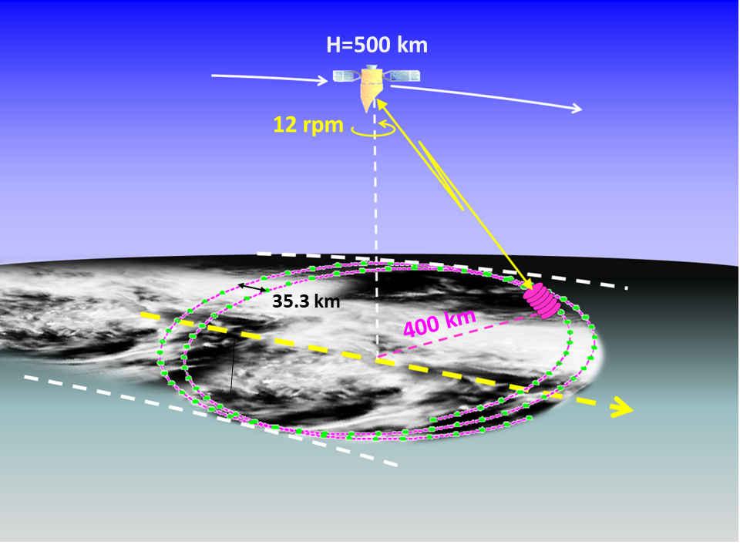
ATMOS-2021 22 Nov 2021 I.6 Earth Explorer Candidate Missions
WIVERN: An EE11 Mission for Observing Global In-Cloud Winds, Clouds and Precipitation - selected for phase 0 studies.
WIVERN: A WInd Velocity Radar Nephoscope Single instrument: 94GHz/3.2mm Doppler radar conically scanning with an 800km swath for global coverage each day.
PRIMARY OBJECTIVE:
Global In-cloud winds using cloud particles as tracers.
SECONDARY OBJECTIVE:
Global rainfall from radar reflectivity (Z)
PLUS snow, cloud water content, cloud depth
Anthony Illingworth, U of Reading:
Alessandro Battaglia, Politecnico Torino U of Leicester/.
+ science team including those involved with assimilating
Aeolus winds at 1) ECMWF, 2) UKMO,
3) Environment Canada, 4) DWD, 5) MeteoFrance

Slide 2
WIVERN – RADAR CONCEPT
500km orbit 800km wide ground track:
41.6° off zenith at surface
One rotation in 5 seconds (12 rpm)
- move 35km along track
For representative winds suitable for data
assimilation accurate 2m/s averaged 20km along footprint track.
3m antenna (maximum possible with current launcher) 94GHz for a narrow beam:
Beamwidth at the surface 800 m. Pulse length 500m (3.3μs)
1. DOPPLER line of sight winds – using cloud particles as tracers.
Winds inside tropical cyclones + deepening Atlantic (and Mediterranean) depressions
Complementing Aeolus Doppler lidar clear-sky and cloud top winds (+ Aeolus follow on)
2. RADAR REFLECTIVITY precipitation rate, cloud profiles, cloud ice water content
3. BENCHMARK for climate record of cloud profiles, global precipitation.
(continuation of CloudSat record since 2006, and EarthCARE 2023 onwards + winds)

Slide 3
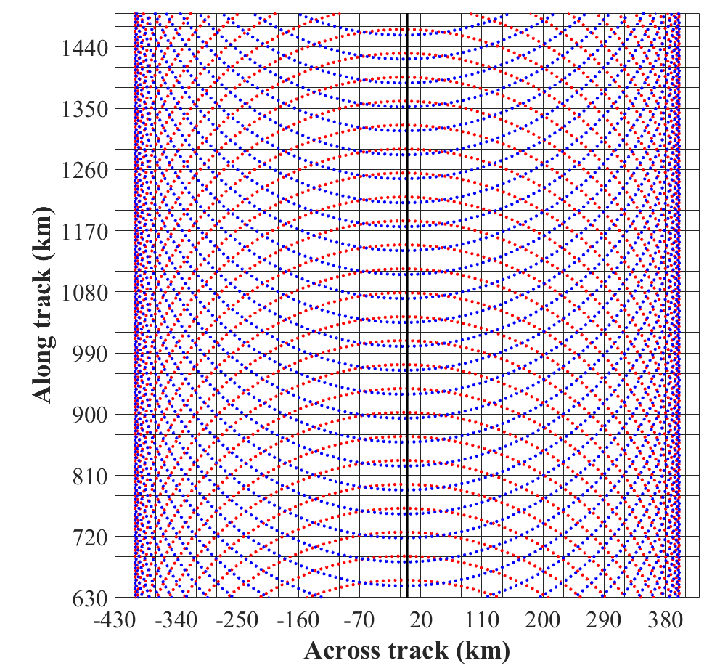
GLOBAL SAMPLING: EACH 30 km BOX IS VISITED WITH A “CURTAIN” OF RADAR DATA
CROSSING IT EACH DAY (ON AVERAGE) UP TO +/-82DEG LATITUDE
800km swath
Sub-satellite point moves at 7km/s.
35km movement along track per circular scan
(5 secs/12rpm)
On the average, each 30km x 30km box has at least one track across it each day to provide wind profiles and rain rates.
Forward view
Rear view

Slide 4
BUT HOW TO MEASURE A DOPPLER SHIFT OF 1m/s ?
Speed of light is 3 10⁸ m/s
Round trip so:
Need to measure change in frequency of return to 1 part in 1.5 10⁸
ONE PART IN 150 MILLION.
3.3us pulse at 94GHz only transmit about 350 waves.
Direct Detection not possible.

Slide 5
DOPPLER RADARS ON THE GROUND SCANNING AZIMUTH HAVE BEEN USING PULSE-PAIR “PP” TECHNIQUE TO ESTIMATE VELOCITIES OF PRECIPITATION FOR MORE THAN FIFTY YEARS
FROM THE GROUND:
Transmit a pair of pulses: Detect change in phase shift, Δϕ, from the two returns.
The maximum unambiguous velocity (V_{FOLD}) occurs when Δ ϕ = +/- 180°
and the particles have moved +/- λ/4.
Ground base weather radar: if λ = 5.6cm λ/4 = 14mm
If pulse every 0.5 msec (so max unambiguous range is 75km).
Folding velocity 14mm/ 0.5msec +/- 28m/s or +/- 100km/hr
FROM SPACE MUST USE 94 GHz/3.2mm to have a 1km footprint on the surface:
λ/4 = 800μm so for 40m/s need pulse separation of just 20μsec
Folding velocity of 800μm/20μsec = +/ 40m/s or +/- 144km/hr
20μsec pulse separation is just 3km in range
– so how do you know which pulse you are receiving?

Slide 6
DOPPLER FROM SPACE? POLARISATION DIVERSITY PULSE PAIR “PDPP”
Use two H & V pulses separated by just 3km/ 20µsec are effectively ‘labelled’: they transmit, scatter and are received independently.
RANGE
PULSE SEPARATION
20µsec OR
3km slant path
(2.3km in the vertical
In that 20µsecs
the target moves
λ/4 in range
H pulse
TIME
φ_{H}
V Pulse 20µs later
λ/4
φ_{V} = φ_{H} + 180°
FOLDING VELOCITY: 800µm in 20µsec = ±40m/s.
If measure phase to 1deg accuracy, better than 0.25m/s
Very simple technique for radar. Won’t work for lidar (Aeolus).
Aeolus: λ = 0.355µm Wavelength is 10,000 times smaller.
λ/4 is a radial movement of ~ 0.1 µm.

Slide 7
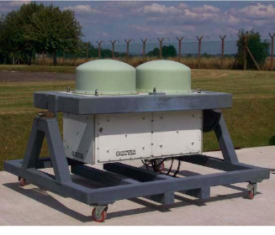
ESA has funded 2 PDPP systems: one ground based and one airborne on the Canadian Convair 850
They transmit H-V 20μs pulse pairs alternating with from 250μsec H-H pulse pairs, the TRUTH. Extensive observations confirm the PDPP velocity is the same as PP velocity. EXACTLY THE SAME PDPP SYSTEM WILL BE USED ON THE WIVERN SATELLITE
GROUND BASED- CHILBOLTON UK CANADA NCR CONVAIR 850 AIRCRAFT
MANY HOURS OF DATA TO CHECK H-V DOPPLER GIVES RELIABLE WINDS
CROSS TALK. DEPOLARISING TARGETS, PULSES 3km APART, VERY LARGE CHANGE IN Z OVER 3km,
the return from the high Z regions will give a GHOST ECHOES IN THE LOW Z REGION
Yes, but the cross-talk signal will have random phase – MAKE WINDS NOISIER BUT NO BIAS

Slide 8
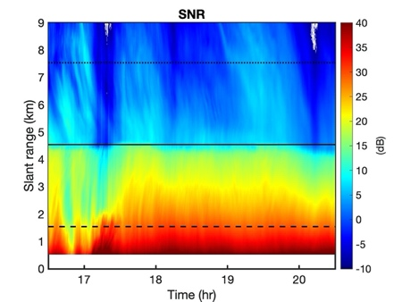
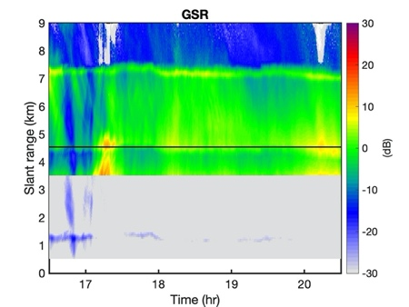
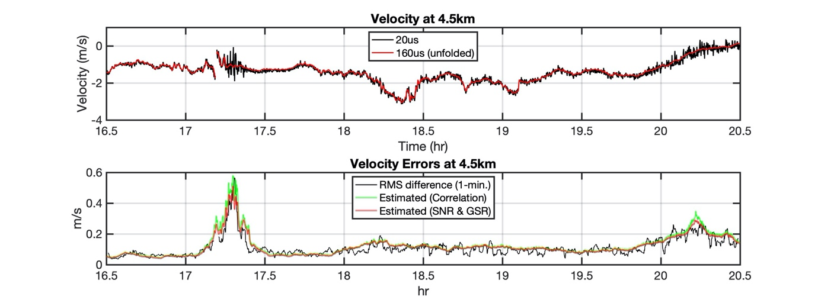
GHOST ECHOES FROM THE GROUND (60m/10 Sec resolution) CONFIRMS NOISIER WINDS.
SIGNAL STRENGTH
4.5 km slant path
GHOST 10dB
HIGHER than signal
4.5 km slant path
ICE SIGNAL 0dB
1.5Kkm slant path
RAIN SIGNAL 35dB
4.5km HEIGHT WINDS
RED LINE – TRUE 250us VELOCITY
BLACK LINE H-V 20usec
noisier when 10dB ghost present
WINDS
AT 4.5KM
HEIGHT
EVERY
10 SECONDS
BLACK LINE RMS ERROR up to 0.5m/s
GREEEN LINE ESTIMATED RMS ERROR
FROM THE CORRELATION
OF THE OBSERVED H-V RETURNS

Slide 9
HERITAGE: CloudSat
CloudSat: first 94GHz radar in space. Launch 2006.
Radar transmitter performed beyond expectations since launch in 2006 and after 15 years is not yet using the spare tube! Nadir pointing: 1.4km wide swath.
CloudSat measured radar reflectivity (Z) profiles (no Doppler) and has provided a global climatology of cloud reflectivity profiles
WIVERN is low risk – will use the same 94GHz klystron, same prf (4kHz) same pulse
power, same pulse length (3.3us/500m) as CloudSat. Use two klystrons: one for H, one for V
DOPPLER PERFORMANCE OF WIVERN
Expect that we can measure the horizontal component of the line of sight (HLOS) wind speed
with a precision of 2m/s for 20 km along track integration for targets with Z > -20dBZ
Using the known climatology of global profiles from CloudSat
We can predict WIVERN should measure > 1 million winds per day
From the vertical gradients of Z ghosts will be very rare when observed from space
Ghost from the depolarising surface will cause noisier winds at a slant path height of 3km.
NEED MORE CANADIAN AIRCRAFT FLIGHTS IN PHASE ZERO TO QUANTIFY THIS EFFECT.

Slide 10
WHAT ABOUT ESTIMATING RAINFALL WITH WIVERN?
Very difficult from space –
Many satellite-based techniques but how are they validated and what are the errors?
The 94GHz radar on CloudSat provides the best global rainfall statistics.
Derived from the drop in the sea surface radar return – the path integrated attenuation.
CloudSat rainfall data has led to a change in the global OLR of about 10 to 20W/m²
Stephens et al. Nature 2012.

Slide 11
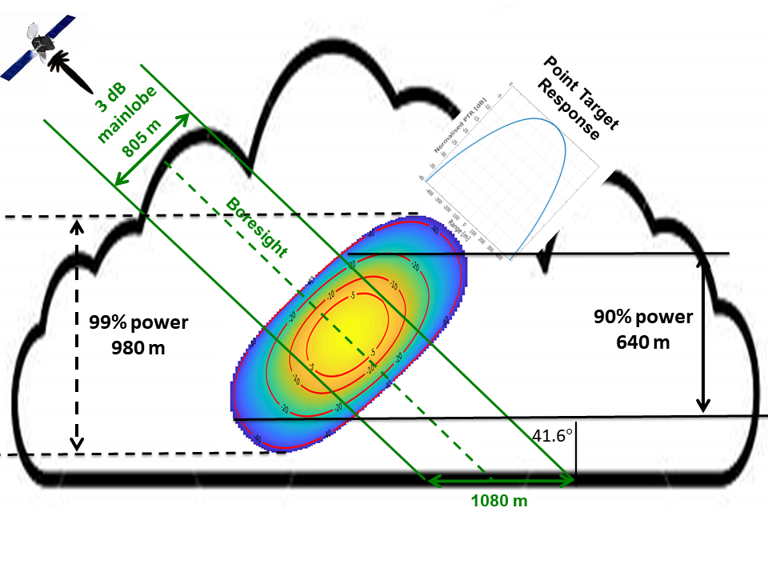
WHAT ABOUT ESTIMATING RAINFALL from Wivern?
Very difficult from space – what are the errors?
Canadian colleagues (Wolde & Nguyen)
have WIVERN pulse compression design
for use on the CONVAIR 850.
This would give a Z measurement for
every 100m along the slant path
rather than 500m at present
Simulations suggest that the Z gradient
and hence the rain rate can be derived
sufficiently accurately
(Also extra 8dB suppression of cross talk!)
Try this with CONVAIR a/c in phase zero
Potential for accurate global rainfall –
over sea and land.
GEOMETRY OF THE WIVERN PULSE VOLUME :
500m pulse length 805m beamwidth.
VERTICAL RESOLUTION 640m
Sample volume red box,

Slide 12
WIVERN – CHALLENGE –ANTENNA POINTING KNOWLEDGE
THE ROTATING ANTENNA induces a COMPONENT of the SATELLITE MOTION
(7 km/s) with an amplitude of 5,000 m/s superposed on the OBSERVED DOPPLER.
Need antenna pointing knowledge to 40μrad over 10 seconds (three sigma)
to reduce the component to 0.2m/s
(antenna beamwidth is about 1 mrad)
PRELIMINARY INDUSTRY STUDY SUGGEST THIS CAN BE DONE.
CRUCIAL TO THE THE MISSION.
NEED MORE INDUSTRIAL STUDIES IN PHASE ZERO

Slide 14
WMO REQUIREMENTS FOR HORIZONTAL WINDS FOR GLOBAL WNP
WMO REQUIREMENTS SURFACE RAINFALL FOR GLOBAL WNP
THRESHOLD, 1mm/hr 50km resolution
BREAKTHROUGH, 0.2mm/hr 15km resolution
GOAL 0.1mm/hr 5km resolution
Can be achieved by rain gauges – but only at a point:
Not achieved by ground-based radar networks (UK 1km resolution every 5 mins).
What about WIVERN?

Slide 15
WIVERN complements Doppler wind lidar winds by observing in areas they cannot see
– within optically thick clouds – thus allowing the full 3D-winds to be captured.
The WIVERN mission will provide:
unprecedented wind observations inside tropical cyclones and mid-latitude windstorms
that will routinely reveal the dynamic structure of such destructive systems;
ii observations of convective motions to validate their representation in NWP models;
iii|) global profiles of cloud properties and precipitation over an 800 km swath that will
better quantify the hydrological cycle and the atmospheric and surface energy budget;
iv) first direct observation of tropospheric dynamics to underpin predictions of transport
and dispersion of trace gases and pollutants in atmospheric chemistry and air quality models.
v) WORK IN PROGRESS: accurate estimates global rainfall over sea and land.

